Slide 1

Image Forgery Detection Using Hybrid CNN-Siamese Networks
Project Associates: Project Guide:
G. Pujitha (22NE1A0439) Mrs.G. Suseelamma,M.Tech., (Ph.D).
D. Bhuvan kumar (22NE1A0429) Associate Professor
B. Divya (22NE1A0418)
G. venu (22NE1A0440)
Department of ECE,TEC

Slide 2
CONTENTS
Introduction
CNN + Resnet 18 Architecture
Literature Review
Motivation
Problem Statement
Objective
Existing Methodology
Proposed Methodology
Tools Required
Advantages and Applications
Quantitative Result Analysis
Conclusion
Future Work
References
CONTENTS
Department of ECE,TEC

Slide 3
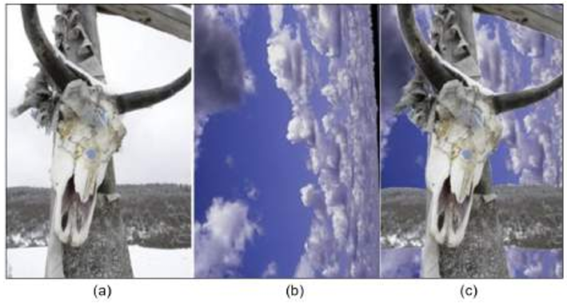
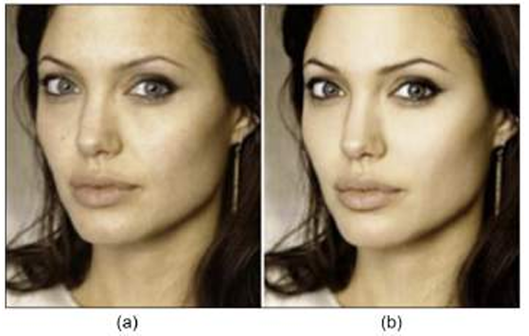
Introduction
Digital images play a crucial role in journalism, social media, and forensic investigations.
Advanced image editing tools have made manipulation easy, increasing the risk of misinformation.
Manual detection of forged images is challenging due to subtle and imperceptible changes.
Common forgery types include copy-move, splicing, object insertion/removal, and retouching.
Fig. 1. Example of two images (a and b) being spliced to generate the image (c) [3]
Fig. 2. Example of an image (a) being forged using the retouching to generate image (b)
Department of ECE,TEC

Slide 4
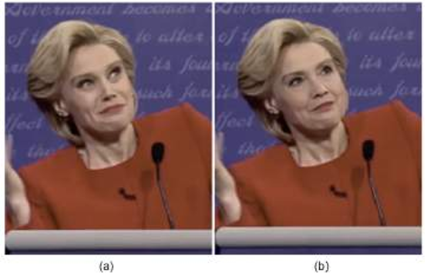
Cont…
Traditional forgery detection methods rely on handcrafted features and domain expertise.
These methods are highly sensitive to noise, compression, and post-processing operations.
Existing CNN-based approaches are often trained on limited or single datasets.
Most deep learning models focus only on binary classification (real vs fake).
Such models fail to generalize well to unseen forgery types and real-world scenarios.
Many existing approaches lack interpretability and do not highlight tampered regions.
The proposed method introduces a hybrid CNN–Siamese network architecture.
Fig. 3. Example of an image (a) being forged using deepfake to generate the image (b)
Department of ECE,TEC

Slide 5
CNN + ResNet 18 Architecture
IIInput Image
Preprocessing
CNN Layers
ResNet-18 Backbone
Global Average Pooling
Fully Connected Layer
Output (Real / Fake)
Department of ECE,TEC

Slide 6
Literature Review
Authors | Title | Year | Publication | Description
C. Song et.al [1] | Image Forgery Detection Based on Motion Blur Estimated Using Convolutional Neural Network | 2019 | IEEE Sensors Journal | It detects tampered regions by learning motion-blur patterns with a CNN and flagging blur inconsistencies as signs of forgery.
J. H. Bappy et.al [2] | Hybrid LSTM and Encoder–Decoder Architecture for Detection of Image Forgeries | 2019 | IEEE | This project uses hybrid LSTM and encoder-decoder networks on resampling features to localize image forgeries like splicing with pixel-level precision on Ms- coco datasets.
F. Marra et.al [3] | A Full-Image End-to-End-Trainable CNN Framework for Image Forgery Detection | 2020 | IEEE Access | This end-to-end CNN framework processes full-resolution images to detect forgeries like splicing by learning noise inconsistencies and localization maps without down sampling
Department of ECE,TEC

Slide 7
Cont…
Authors | Title | Year | Publication | Description
L. Zhao et.al [4] | Deep Learning-Based Forgery Attack on Document Images | 2021 | IEEE Transactions | ForgeNet, a deep learning model, generates realistic forgeries on document images by manipulating text and backgrounds to bypass authentication systems.
K. M. Hosny et.al [5] | An Efficient CNN Model to Detect Copy-Move Image Forgery | 2022 | IEEE Access | This paper efficiently detects copy move forgeries by extracting multi-scale features and using a similarity network to localize duplicated regions with high accuracy.
N. Dhiman et.al [6] | An Efficient Approach for Image Forgery Detection Using Deep Convolutional Neural Network | 2023 | IEEE conference | This approach uses a deep CNN to detect image forgeries by extracting multi-level features from noise patterns and achieving precise localization of tampering like copy-move or splicing.
Department of ECE,TEC

Slide 8
Cont…
Authors | Title | Year | Publication | Description
M. H. Mutar et.al [7] | Innovative Deep Learning Solutions for Image Forgery Detection | 2024 | IEEE conference | This paper presents innovative deep learning models like CNNs and GANs for robust image forgery detection, focusing on splicing and copy-move attacks via noise analysis and feature fusion.
Meepaganithage et.al [8] | Image Forgery Detection Using Convolutional Neural Networks | 2024 | IEEE conference | This CNN-based method detects image forgeries like copy-move and splicing by learning spatial and noise inconsistencies across image patches for accurate localization
Department of ECE,TEC

Slide 9
Motivation
Existing CNN models use single datasets and binary classification, limiting real-world use.
Real-world images involve multiple forgery types and post-processing operations.
Current methods lack generalization and robustness.
Handcrafted features are fragile; deep models are dataset-specific.
Lack of precise localization of tampered regions.
Need for a unified deep learning framework.
Use ResNet for feature extraction.
Siamese network for similarity learning.
U-Net for pixel-level segmentation.
Multi-dataset training improves accuracy and interpretability.
Department of ECE,TEC

Slide 10
Problem Statement
Existing CNN-based image forgery detectors are often trained on single datasets, such as Kaggle, and show limited generalization across diverse forgery types, including copy-move, splicing, and retouching.
Most current methods focus only on binary classification (authentic vs. forged) and do not provide sufficient interpretability at the region level, reducing their practical usefulness in forensic investigations.
There is a need for a unified deep learning framework that combines robust feature extraction using CNNs with similarity learning through Siamese networks to detect tampering and identify suspicious regions.
Existing approaches are rarely evaluated under real-world distortions, such as JPEG compression, Gaussian noise, and geometric transformations, limiting their deployment in forensic and media authentication applications.
Department of ECE,TEC

Slide 11
Objective
To improve cross-dataset robustness by extending the baseline CNN-based forgery detector using multiple benchmark datasets such as CASIA2, CoMoFoD, and NC2016, enabling better generalization across different forgery types.
To design and implement a hybrid CNN–Siamese architecture that extracts deep spatial and statistical features from images and compares original and suspicious images to detect tampering based on feature similarity.
To analyze region-level forensic inconsistencies, including noise irregularities, compression artifacts, and statistical variance, in order to support interpretable forgery detection decisions.
To evaluate the proposed model under real-world distortions such as JPEG compression (70–95%), Gaussian noise, and geometric transformations to assess practical forensic reliability.
To achieve improved forgery detection performance by comparing the proposed approach with a ResNet-101 baseline model and demonstrating enhanced robustness and accuracy.
Department of ECE,TEC

Slide 12
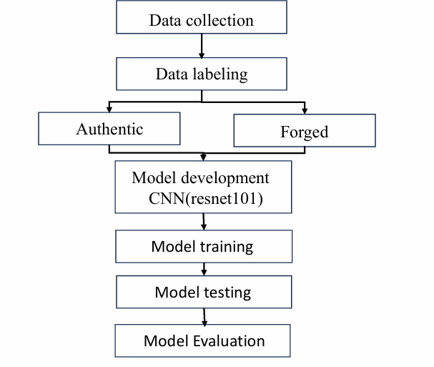
EXISTING METHODOLOGY
Figure 1: Block Diagram of Existing Image forgery detection.
12
Department of ECE,TEC

Slide 13
Cont…
Existing System :
Manual and semi-automated forgery detection
Uses handcrafted features (SIFT, DCT, LBP)
Requires expert knowledge
Low accuracy for complex forgeries
Not scalable for large datasets
Limitations of Existing System :
Sensitive to noise and compression
Poor generalization capability
Time-consuming analysis
No user-friendly interface
13
Department of ECE,TEC

Slide 14
Proposed Methodology
Data Collection
Data Preprocessing
Model Selection (CNN + ResNet18)
Model Training
Model Evaluation
System Integration
Testing & validation
Department of ECE,TEC

Slide 15
Cont…
Data Collection
Authentic and forged image datasets are collected from public sources such as CASIA v2.0, CoMoFoD, and NC2016.
These datasets cover multiple forgery types including copy-move, splicing, and object removal.
Images are sourced from Kaggle and other repositories to ensure diversity in content, resolution, and format.
Noise and irrelevant data are removed to maintain dataset quality and prevent model confusion.
Data Preprocessing
All images are resized to a uniform dimension to ensure compatibility with the CNN input layer.
Data augmentation techniques such as rotation, flipping, and scaling are applied to increase dataset diversity.
Images are converted to consistent file formats and color spaces to maintain uniformity across the dataset.
Model Training (CNN)
Organize data into Training and Validation sets.
A Convolutional Neural Network (CNN) architecture is implemented with layers including convolution, pooling, and fully connected layers.
Department of ECE,TEC

Slide 16
Cont…
The model is trained to identify forgery patterns by learning spatial and statistical features from images.
Hyperparameters such as learning rate, batch size, and number of epochs are optimized during training.
Data Evaluation
Evaluation metrics including accuracy, precision, recall, and F1-score are computed to assess classification performance.
Confusion matrices and ROC curves are generated to visualize model strengths and weaknesses.
Parameters are fine-tuned based on evaluation results to achieve higher accuracy and better generalization.
System Integration (Flask)
The trained model is connected to a web interface using the Flask framework as the backend middleware.
Flask handles HTTP requests from the frontend, processes uploaded images, and returns model predictions.
Smooth data handling is ensured through proper validation, preprocessing, and error management between frontend and model.
API endpoints are structured for easy integration with web interfaces and potential future mobile applications.
Department of ECE,TEC

Slide 17
Cont…
Testing & Validation
The system is tested with real-world forged images to evaluate practical forensic performance.
Robustness is validated using images subjected to post-processing operations like compression and noise addition.
Overall system reliability is assessed through extended runtime testing and edge case handling.
Comparative analysis against existing methods confirms the effectiveness of the proposed framework.
Department of ECE,TEC

Slide 18
Dataset Description
The CASIA v2.0, CoMoFoD, and NC2016 datasets are obtained from Kaggle and are widely used for training and evaluating digital image forgery detection algorithms.
These datasets cover major image tampering techniques, including copy-move, splicing, and object removal, making them suitable for general forgery detection tasks.
CASIA v2.0 is a large-scale benchmark dataset containing over 12,000 authentic images and 7,000 manipulated images, with realistic forgeries and blurred boundaries.
CoMoFoD is specifically designed for copy-move forgery detection and includes images subjected to post-processing operations such as noise addition and compression.
The NC2016 dataset originates from a NIST challenge and contains highly sophisticated and realistic forgeries that are difficult to detect, representing real-world forensic scenarios.
Although some datasets provide binary ground-truth masks indicating tampered regions, they are used in this project only for evaluation and validation purposes, not for pixel-level segmentation.
The datasets include images in various file formats such as JPEG, TIFF, and BMP, and contain diverse visual content including landscapes, indoor scenes, and objects.
Department of ECE,TEC

Slide 19
Tools Required
Core Logic: Python 3.x serves as the primary programming language for implementing backend logic and deep learning algorithms.
Deep Learning Frameworks: The project utilizes PyTorch and TensorFlow to develop and train the hybrid ResNet Siamese U-Net and custom CNN models.
Data & Image Processing: NumPy and Pandas handle data preprocessing, while OpenCV and PIL are used for image loading, resizing, and visualizing tampered regions.
Web Interface: The frontend is built with HTML, CSS, and JavaScript, powered by a Flask backend to provide a functional user interface.
Environment & Data: Development is conducted in Google Colab, Jupyter, or PyCharm, using datasets like CASIA v2.0, CoMoFoD, and NC2016 for robustness testing.
Department of ECE,TEC

Slide 20
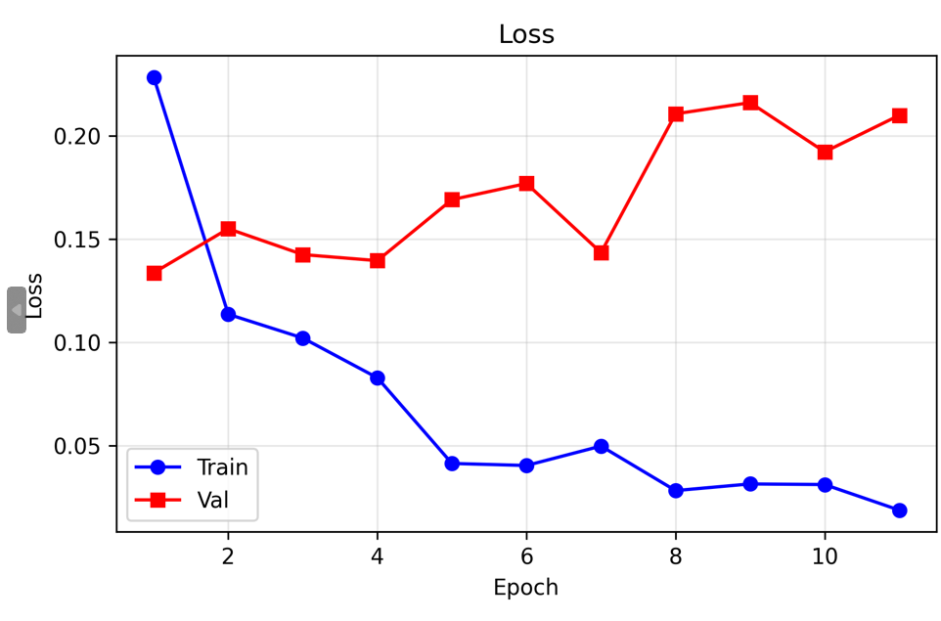
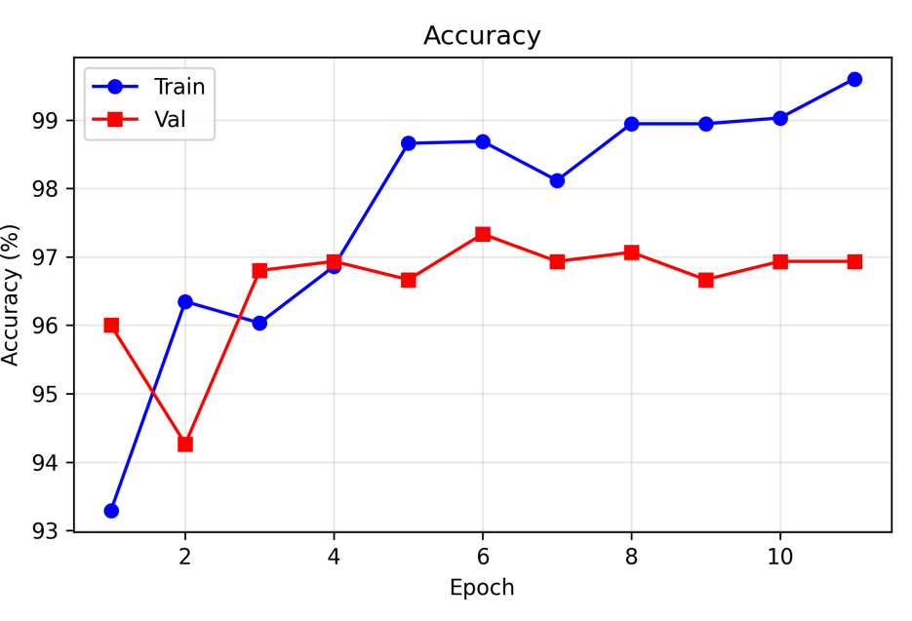
Quantitative Result Analysis
Training And Validation Graphs of ResNet18
Fig: Training and validation loss
Fig: Training and Validation Accuracy
Department of ECE,TEC

Slide 21
Cont…
Proposed methodology Analysis
Evaluation | ResNet 18
Accuracy | 96.9
Precision | 98.6
Recall | 98.6
Specificity | 96.9
F1 score | 97.8
Existing Methodology Analysis
Evaluation | Resnet 101
Accuracy | 93.46
Precision | 95.08
Recall | 92.10
Specificity | 94.91
F1 score | 93.57
Department of ECE,TEC

Slide 22
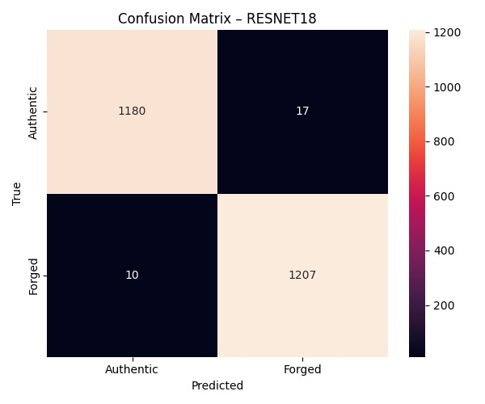
Cont…
Formula:
Accuracy = (TP + TN) / (TP + TN + FP + FN)
= (1207 + 1180) / (1207 + 1180 + 17 + 10) = 2387 / 2414 ≈ 96.88%
Precision = TP / (TP + FP)
= 1207 / (1207 + 17)
≈ 98.61%
Recall = TP / (TP + FN)
= 1207 / (1207 + 10)
≈ 98.18%
F1 Score = 2 × (Precision × Recall) / (Precision + Recall)
≈ 97.89%
Fig : Confusion Matrix of ResNet18
Department of ECE,TEC

Slide 23
Cont…
Features | Existing Methodology | Praposed Methodology
Methodology | Uses only deep learning (CNN) classification on a balanced dataset. | Uses a hybrid approach: Deep Learning (ResNet) + Heuristic Forensic Analysis
Models used | CNN + ResNet-101 (93.46% accuracy). | CNN + ResNet-18 (96.9% accuracy).
System Output | A classification result (authentic/ forged) and performance metrics. | A web application that provides a prediction, confidence score, and detailed forensic analysis reports.
Additional Functionality | No additional features. The system is strictly a classifier with no user interaction beyond training and testing. | Includes Dual Image Comparison feature allowing users to upload two images and analyze differences to detect potential manipulation from an original reference.
Dataset Strategy | Uses a single Kaggle dataset with 6,500 authentic and 6,500 forged images. Data split is 80-10-10 for training, validation, and testing. | Uses a custom-built, structured dataset collected from multiple sources and categorized by manipulation type (copy-move, splicing, inpainting).
Department of ECE,TEC

Slide 24
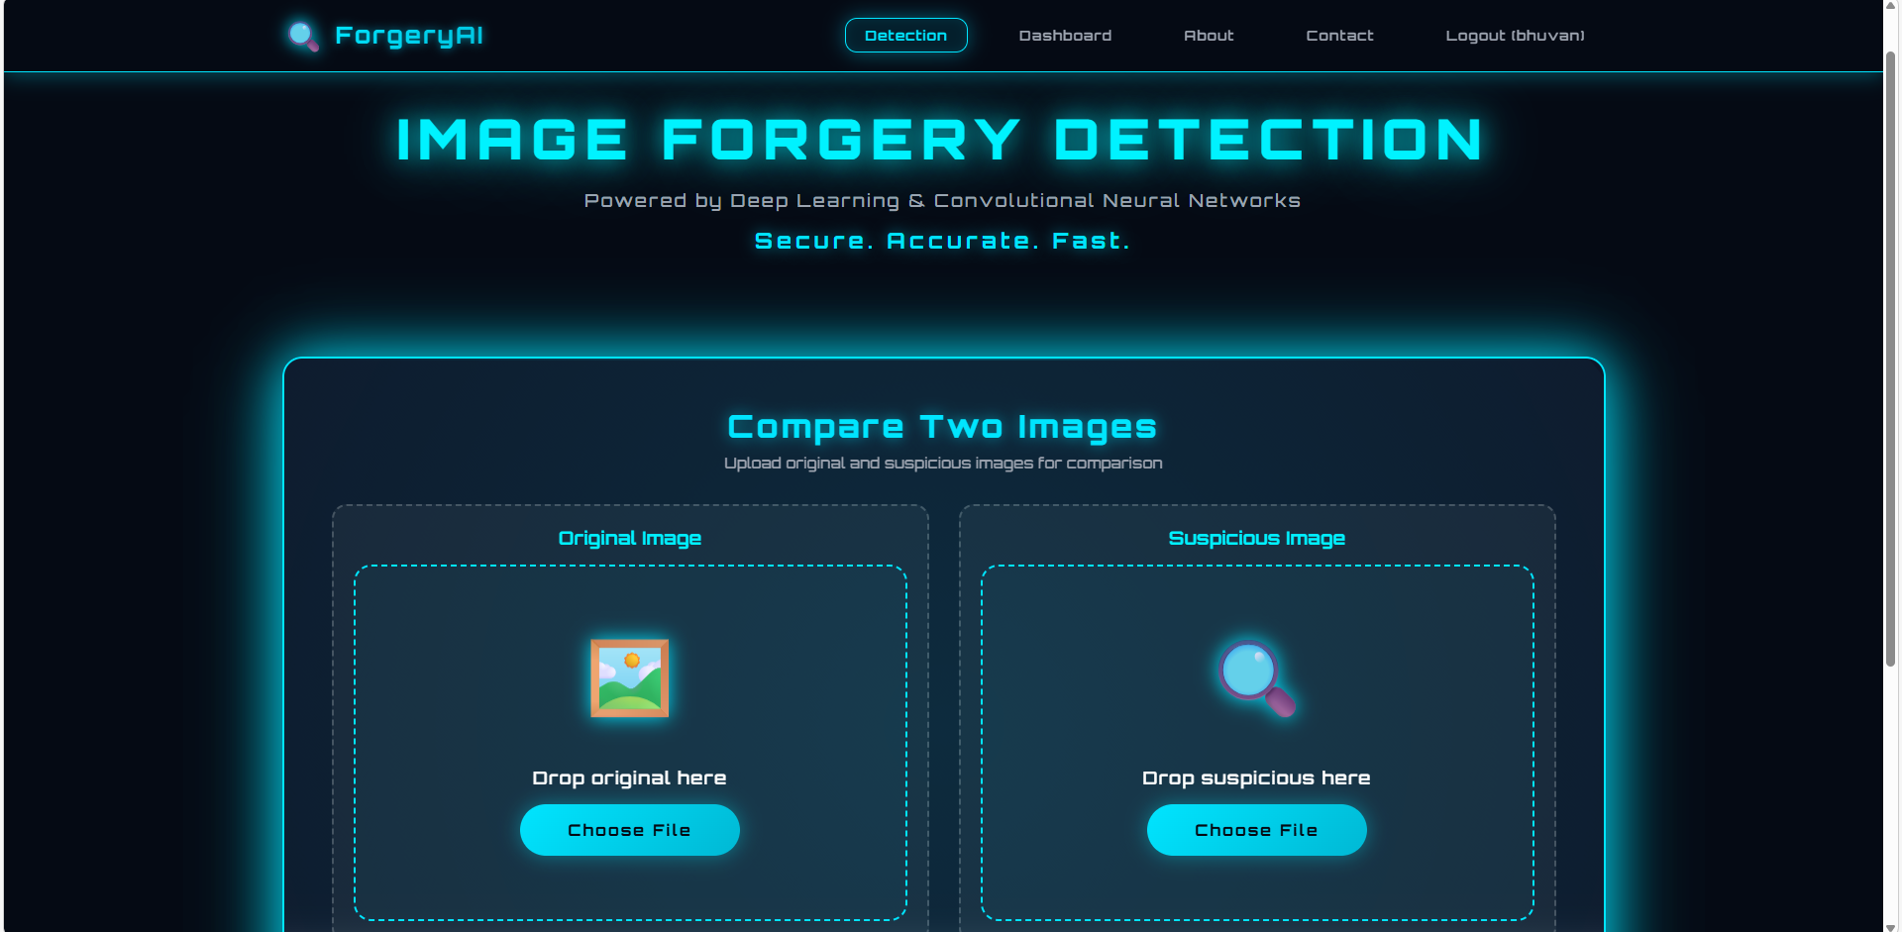
Results
Fig : Image Forgery Detection website
Department of ECE,TEC

Slide 25
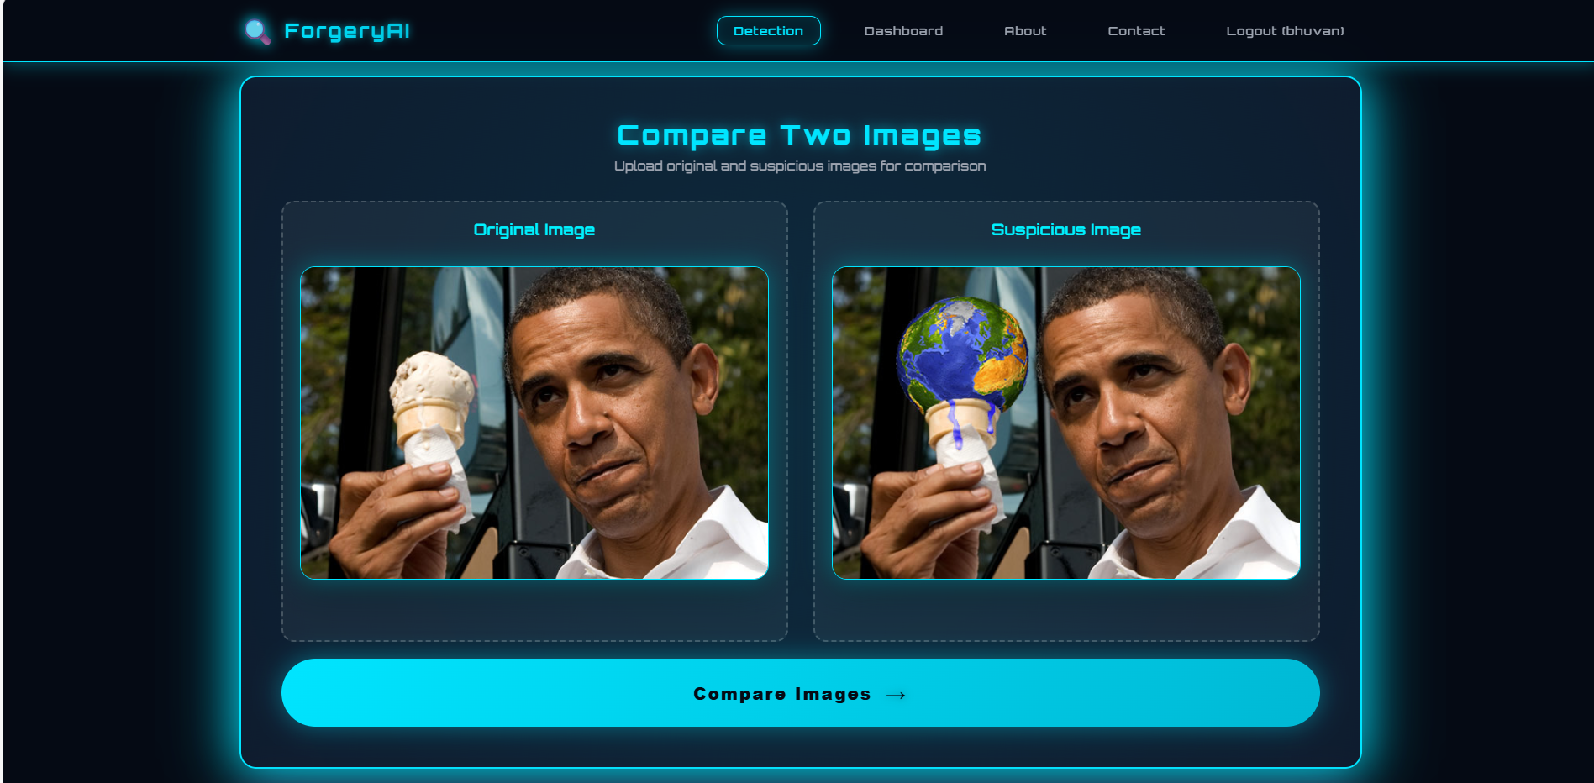
Cont…
Fig : Providing the original Image and Suspicious Image
Department of ECE,TEC

Slide 26
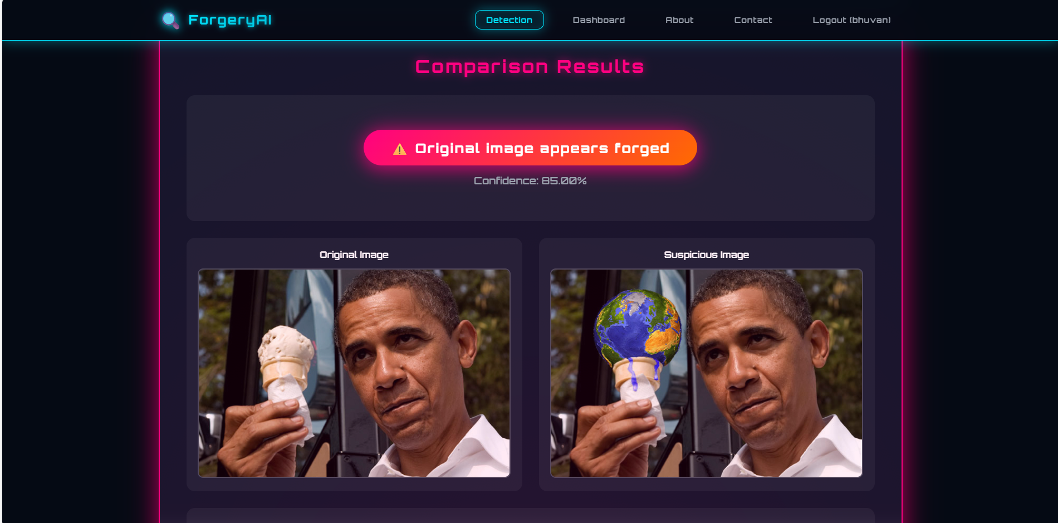
Cont…
Fig : The image is Forged
Department of ECE,TEC

Slide 27
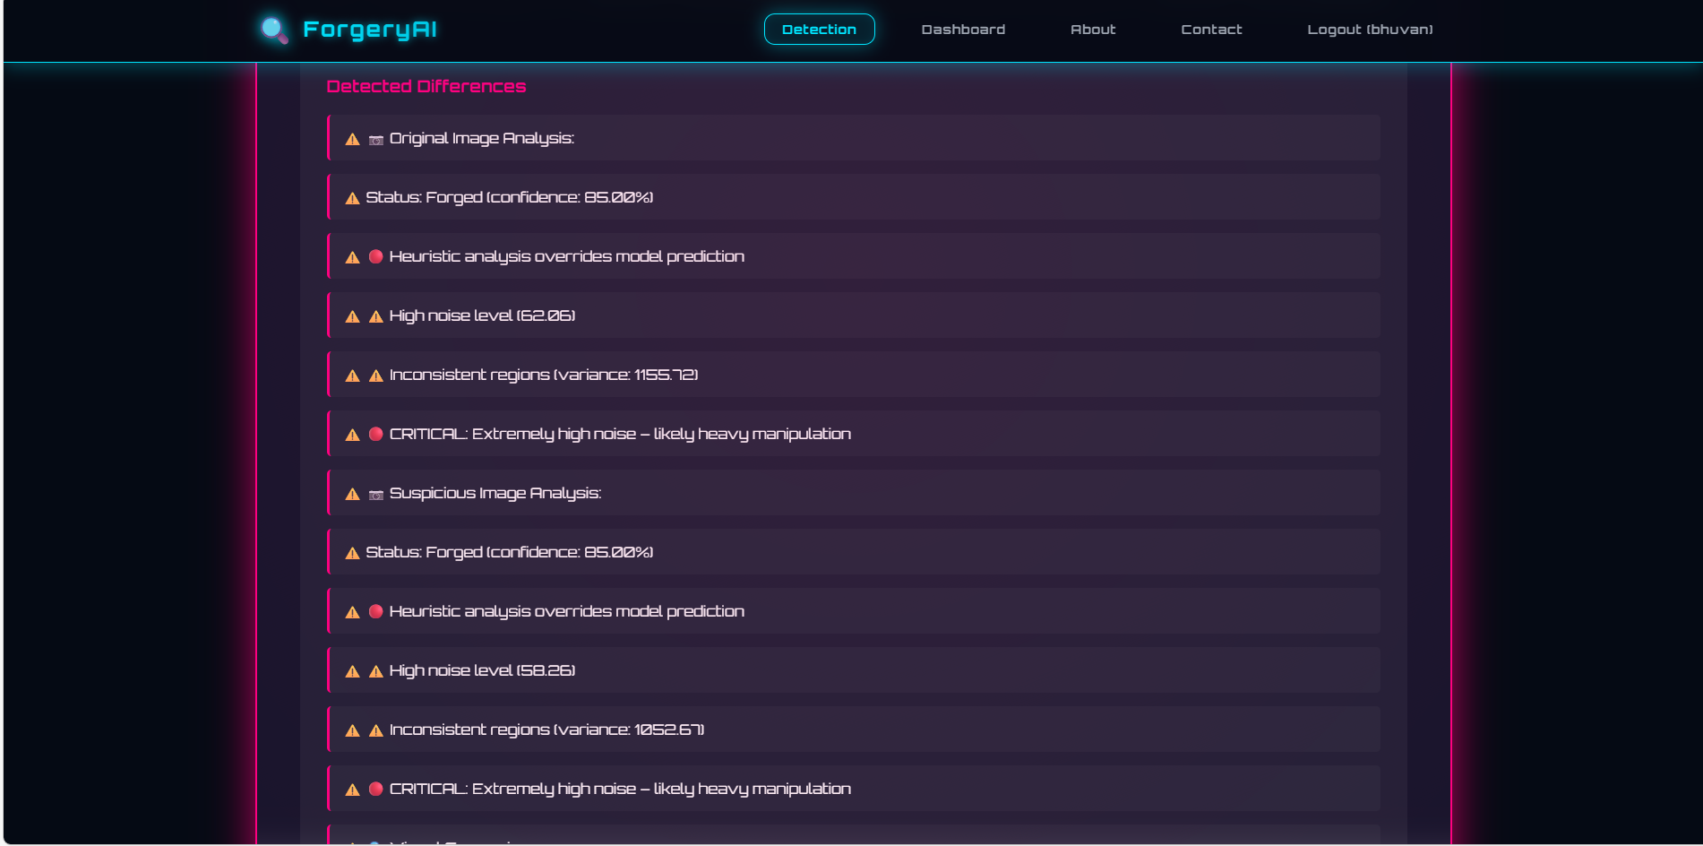
Cont…
Fig : Differences between two images
Department of ECE,TEC

Slide 28
Advantages And Applications
Advantages:-
Automatic and accurate detection
Reduced human intervention
Scalable and efficient
User-friendly web application
Can be extended to video forgery detection
Applications:-
Forensics:-Verifies evidence photos in criminal cases.
Journalism:-Authenticates news images against fakes.
Social Media:-Flags manipulated content to curb misinformation.
Insurance:-Detects altered claim photos to prevent fraud.
E-commerce:-Ensures genuine product images in listings.
Department of ECE,TEC

Slide 29
Conclusion
The main goal of this project was to build a reliable system for detecting forged or manipulated images using deep learning and digital forensic techniques. To achieve this, the team trained and evaluated ResNet architectures (ResNet-18, ResNet-50, and ResNet-101) using transfer learning from ImageNet. Among these, ResNet-101 performed best, achieving 93.46% test accuracy, 95.08% precision, 92.10% recall, 94.91% specificity, and a 93.57% F1-score. To further improve reliability, the system integrates a hybrid forensic analysis framework that examines noise levels, JPEG compression artifacts, edge consistency, color distribution, and local variance helping detect manipulations that deep learning alone might miss. A Flask-based web application was also developed, allowing users to easily upload images and receive instant detection results with detailed forensic reports.
Although the system performs well, it has limitations its effectiveness depends on the diversity of training data, and it may struggle with unseen manipulation techniques, additionally, the forensic heuristics rely on predefined thresholds that may not generalize to all image types. Overall, combining deep learning with heuristic forensic analysis significantly enhances the accuracy and robustness of image forgery detection, offering a practical solution for digital forensics, media verification, and cybersecurity.
Department of ECE,TEC

Slide 30
Future work
Although the image forgery detection system works well, there are several ways to make it even better in the future. The training dataset should be expanded with more types of fake images to help the model learn better. The system also needs to learn how to detect images created by AI tools like GANs and diffusion models, which produce very realistic fakes. It could also be extended to detect fake videos, including deepfakes, by analyzing both individual frames and changes between frames. Making the system more explainable for example, by highlighting which parts of an image led to a fake decision would help users trust the results. Privacy-preserving methods like federated learning could allow organizations to work together on improving the model without sharing sensitive data.
Finally, adding blockchain technology could create tamper-proof records of image authenticity, which would be useful for legal cases. In short, with these improvements, the system can become an even more powerful and reliable tool for detecting fake images.
Department of ECE,TEC

Slide 31
REFERENCES
[1] C. Song, P. Zeng, Z. Wang, T. Li, L. Qiao and L. Shen, "Image Forgery Detection Based on Motion Blur Estimated Using Convolutional Neural Network," in IEEE Sensors Journal, vol. 19, no. 23, pp. 11601-11611, 1 Dec.1, 2019, doi: 10.1109/JSEN.2019.2928480.
[2] J. H. Bappy, C. Simons, L. Nataraj, B. S. Manjunath and A. K. Roy-Chowdhury, "Hybrid LSTM and Encoder–Decoder Architecture for Detection of Image Forgeries," in IEEE Transactions on Image Processing, vol. 28, no. 7, pp. 3286-3300, July 2019, doi: 10.1109/TIP.2019.2895466.
[3] F. Marra, D. Gragnaniello, L. Verdoliva and G. Poggi, "A Full-Image Full-Resolution End-to-End-Trainable CNN Framework for Image Forgery Detection," in IEEE Access, vol. 8, pp. 133488-133502, 2020, doi: 10.1109/ACCESS.2020.3009877.
[4] L. Zhao, C. Chen and J. Huang, "Deep Learning-Based Forgery Attack on Document Images," in IEEE Transactions on Image Processing, vol. 30, pp. 7964-7979, 2021, doi: 10.1109/TIP.2021.3112048.
Department of ECE,TEC

Slide 32
Cont…
[5] K. M. Hosny, A. M. Mortda, M. M. Fouda and N. A. Lashin, "An Efficient CNN Model to Detect Copy-Move Image Forgery,"in IEEE Access,vol. 10, pp. 48622-48632, 2022,
doi: 10.1109/ACCESS.2022.3172273.
[6] N. Dhiman, H. Singh and A. Thakur, "An Efficient Approach for Image Forgery Detection Using Deep Convolutional Neural Network," 2023 International Conference on Electrical, Electronics, Communication and Computers (ELEXCOM), Roorkee, India, 2023, pp. 1-5,
doi: 10.1109/ELEXCOM58812.2023.10370304.
[7] M. H. Mutar, R. Al-Fatlawy, H. A. Rasool, R. R. Ghafour, F. H. Abbas and D. J. Hashim, "Innovative Deep Learning Solutions for Image Forgery Detection," 2024 Asian Conference on Communication and Networks (ASIANComNet), Bangkok, Thailand, 2024, pp. 1-7,
doi: 10.1109/ASIANComNet63184.2024.10811035.
[8] A. Meepaganithage, S. Rath, M. Nicolescu, M. Nicolescu and S. Sengupta, "Image Forgery Detection Using Convolutional Neural Networks," 2024 12th International Symposium on Digital Forensics and Security (ISDFS), San Antonio, TX, USA, 2024, pp. 1-6, doi: 10.1109/ISDFS60797.2024.10527268.
Department of ECE,TEC

Slide 33

Thank You
Department of ECE,TEC

